Slide 1
AZ-100.1 Module 02: Access Management for Cloud Resources

Slide 2
Lesson 01: Azure Users and Groups

Slide 3
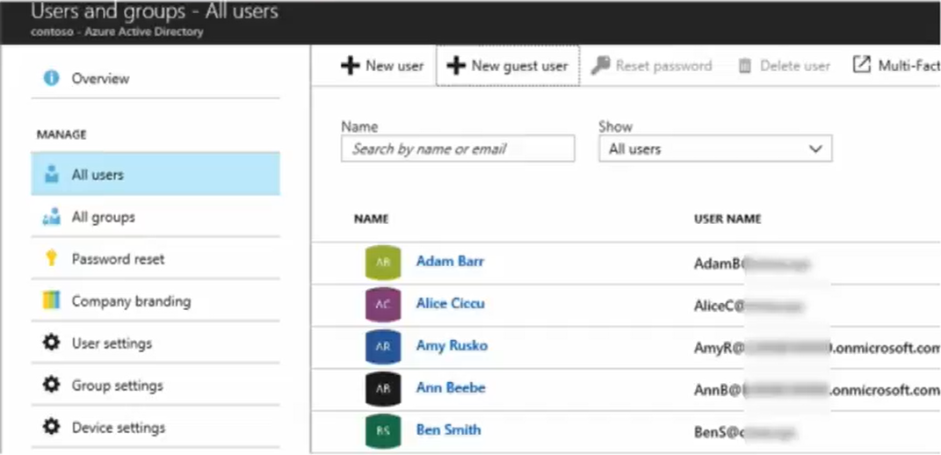
Video: Managing Users and Groups

Slide 4
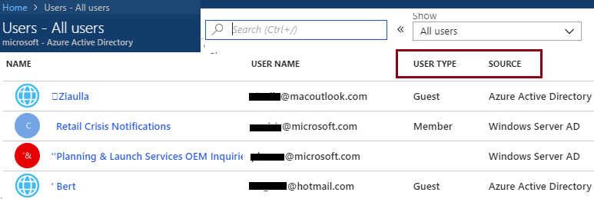
User Accounts
All users must have a user account
The account is used for authentication and authorization
Identity Sources: Cloud, Directory-synchronized, and Guest
Notes:
✔️ Take a minute to access the Portal and view your users. Notice the User Type and Source columns. Have you given any thought as to the type of users you will need?

Slide 5
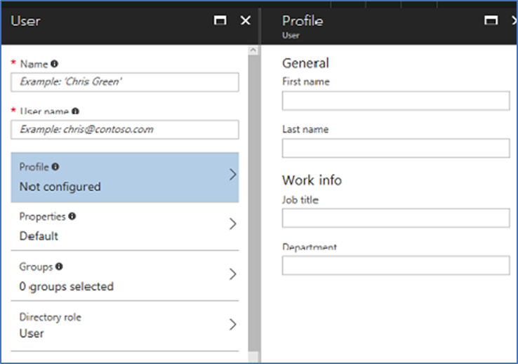
Adding User Accounts
# Create a password object
$PasswordProfile = New-Object -TypeName Microsoft.Open.AzureAD.Model.PasswordProfile
# Assign the password
$PasswordProfile.Password = "<Password>“
# Create the new user
New-AzureADUser -AccountEnabled $True -DisplayName "Abby Brown" -PasswordProfile $PasswordProfile -MailNickName "AbbyB" -UserPrincipalName AbbyB@contoso.com
Notes:
✔️ Users can also be added to Azure AD through Office 365 Admin Center, Microsoft Intune admin console, and the CLI. Which of the options mentioned in this topic do you prefer?
For more information, you can see:
Add or change profile information for a user in Azure Active Directory - https://docs.microsoft.com/en-us/azure/active-directory/active-directory-users-profile-azure-portal
Creating a new user in Azure AD - https://docs.microsoft.com/en-us/powershell/azure/active-directory/new-user-sample?view=azureadps-2.0
az ad user create - https://docs.microsoft.com/en-us/cli/azure/ad/user?view=azure-cli-latest#az_ad_user_create

Slide 6
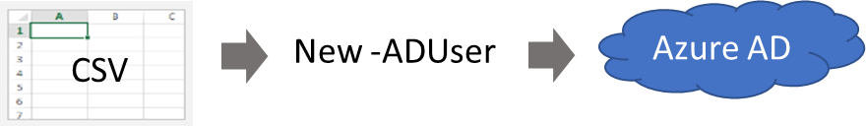
Bulk User Accounts
Use Connect-AzureAD to create a PowerShell connection to your directory
Create a new Password Profile for the new users
Use Import-CSV to import the csv file
Loop through the users in the file constructing the user parameters
Use New-ADUser to create each user
Be sure to enable each account
Notes:
✔️ Establish or implement a naming convention for usernames, display names and aliases. The password for the new users needs to conform to the password complexity rules you have set for your directory. User parameters include User Principal Name, Display Name, Given Name, Department, and Job Title.
For more information, you can see:
Importing data into my directory - https://docs.microsoft.com/en-us/powershell/azure/active-directory/importing-data?view=azureadps-2.0
New-ADUser - https://docs.microsoft.com/en-us/powershell/module/azuread/new-azureaduser?view=azureadps-2.0

Slide 7
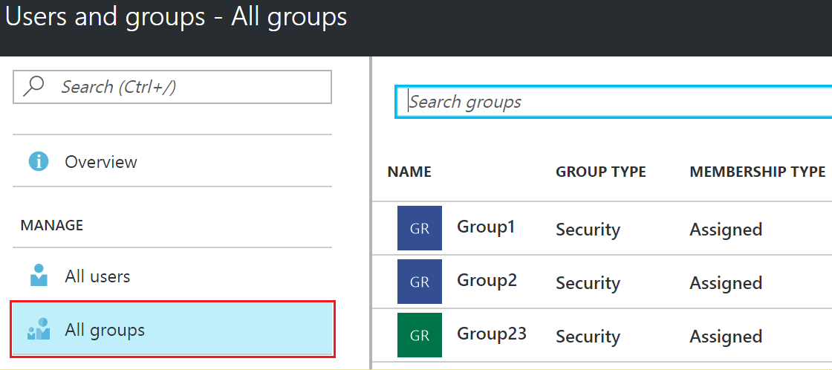
Group Accounts
Security groups
Distribution groups
Directly assigned
Dynamically assigned
New-AzureADGroup -Description "Marketing" -DisplayName "Marketing" -MailEnabled $false -SecurityEnabled $true -MailNickName "Marketing"
Notes:
✔️ Have you given any thought to which groups you need to create? Would you directly assign or dynamically assign membership?
For more information, you can see:
Manage group membership for users in your Azure Active Directory tenant - https://docs.microsoft.com/en-us/azure/active-directory/active-directory-groups-members-azure-portal
Create attribute-based rules for dynamic group membership in Azure Active Directory - https://docs.microsoft.com/en-us/azure/active-directory/active-directory-groups-dynamic-membership-azure-portal
Create a group and add members in Azure Active Directory - https://docs.microsoft.com/en-us/azure/active-directory/active-directory-groups-create-azure-portal
New-AzureADGroup - https://docs.microsoft.com/en-us/powershell/module/azuread/new-azureadgroup?view=azureadps-2.0

Slide 8
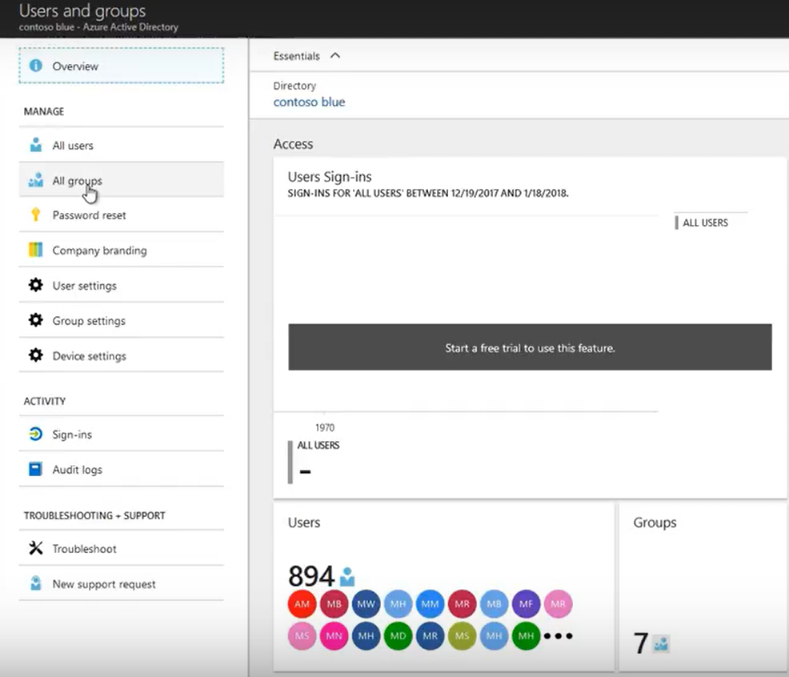
Demonstration: Create User and Group Accounts
Notes:
✔️As you have time, experiment with other user and group administrative tasks. Also, if you want to try some of these tasks using PowerShell, see the Azure Active Directory PowerShell 2.0 cmdlet reference for Azure AD.

Slide 9
Additional Practice: Users and Groups
Work with users and groups in your Active Directory
Add new users
Manage group membership
Create a group and add members
Manage profile information
Notes:
✔️ For the Quickstarts in this practice, you will to sign in to Azure with an account that’s a global admin for the directory.
✔️As you have time, experiment with other user and group administrative tasks. Also, if you want to try some of these tasks using PowerShell, see the Azure Active Directory PowerShell 2.0 cmdlet reference for AzureAD (https://docs.microsoft.com/en-us/powershell/module/Azuread/?view=azureadps-2.0)

Slide 10
Lesson 02: Role-based Access Control

Slide 11
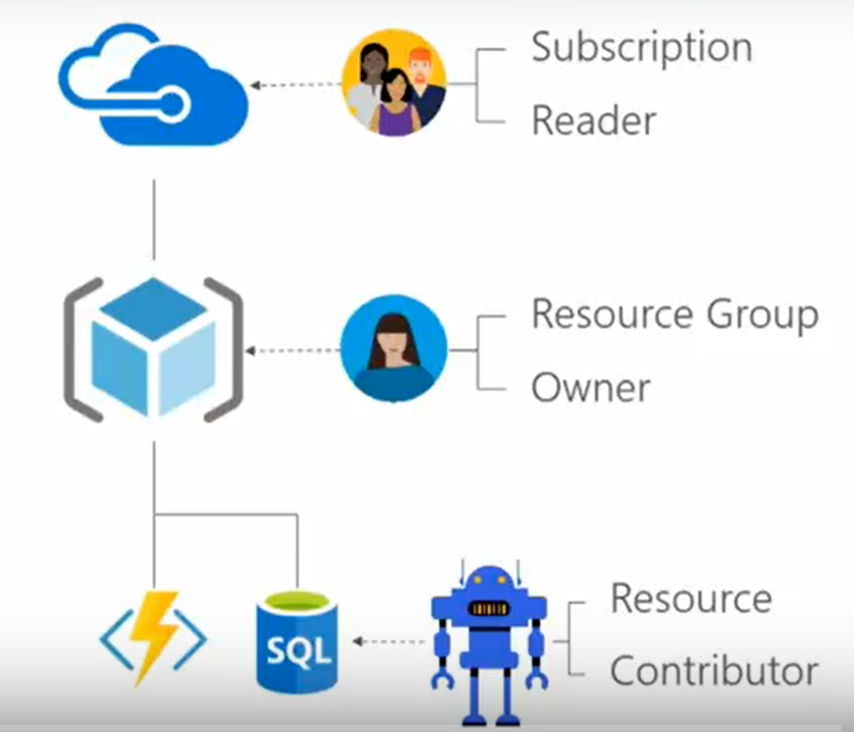
Video: Role-Based Access Control

Slide 12
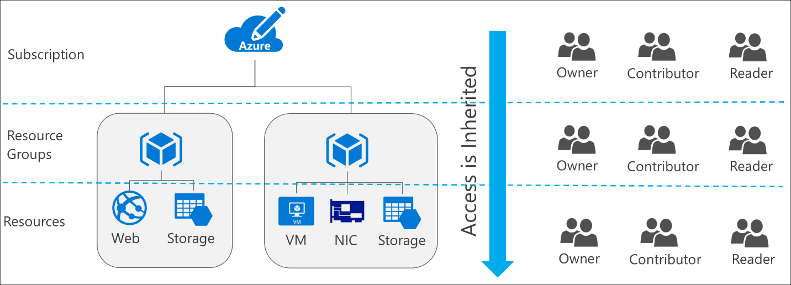
RBAC Concepts
Define what actions are allowed and/or denied
Associate the role with a user, group or service principal
Scope to a subscription, a resource group, or specific resources
Notes:
✔️ Take a minute to access the Portal and view your users. Notice the User Type and Source columns. Have you given any thought as to the type of users you will need?
✔️ Users and groups are sourced from Azure Active Directory, which is commonly populated with credentials from on-premises directories, such as Active Directory. Note that RBAC access that you grant at parent scopes is inherited at child scopes.
For more information, see:
Get started with access management in the Azure portal: https://docs.microsoft.com/en-us/azure/active-directory/role-based-access-control-what-is

Slide 13
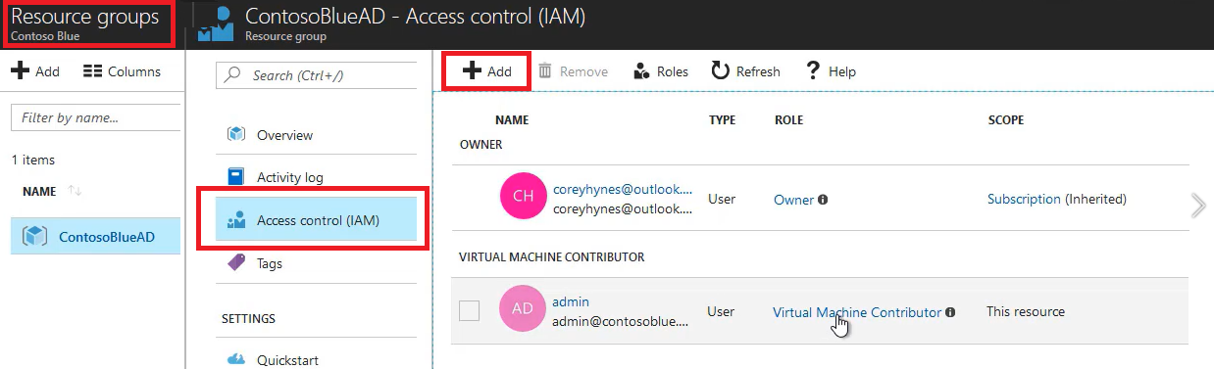
Roles
Owner can manage everything, including access
Contributors can manage everything except access
Readers can view everything but can't make changes

Slide 14
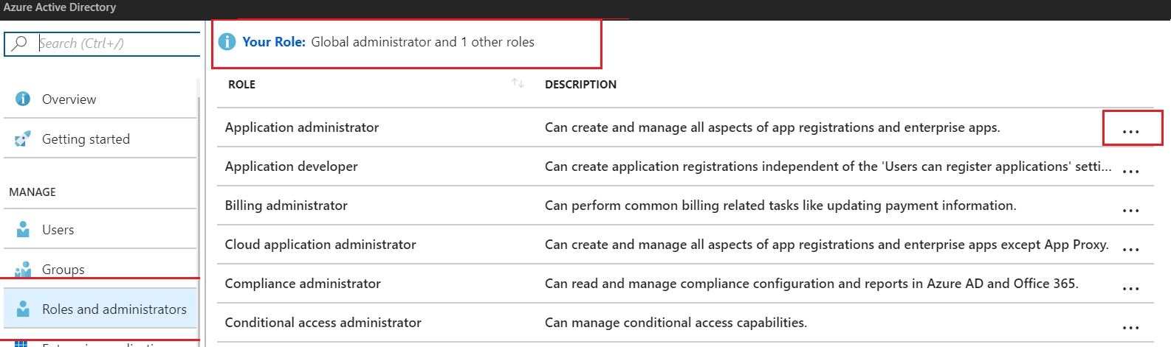
Administrator Permissions
Designate separate administrators for different functions
Global administrators can access all administrative features
Global administrators can assign other administrators
Notes:
✔Are you using the Azure forums to find information and post questions? If not, try the reference link.
For more information, you can see:
Assigning administrator roles in Azure Active Directory - https://docs.microsoft.com/en-us/azure/active-directory/users-groups-roles/directory-assign-admin-roles
Available roles - https://docs.microsoft.com/en-us/azure/active-directory/users-groups-roles/directory-assign-admin-roles#available-roles
Active Directory Forum - https://feedback.azure.com/forums/169401-azure-active-directory?category_id=166032

Slide 15
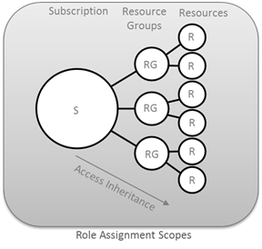
Resource Scope
Roles can be assigned for resources groups and individual resources
Resource inherits role assignments from its parent resources

Slide 16
Role Assignment
Users
Assigned to organizational users in the AD associated with the subscription
Or, external Microsoft accounts in the same directory
Groups
Assigned to Azure AD security groups
Best practice: manage access through groups, adding roles, and assigning users
Service Principals
Service identities represented as service principals in the directory
Authenticate with Azure AD and securely communicate with one another
Notes:
✔Explain the benefits of role assignment that allows you to associate a security principal to a role, and how this decoupling lets you specify a specific role has access to a resource in your subscription. Also to add/remove security principals in a loosely connected manner.

Slide 17
Role Definitions
Built-in Role | Action | NotActions
Owner (allow all actions) | *
Contributor (allow all actions except writing or deleting role assignment) | * | Microsoft.Authorization/*/Delete, Microsoft.Authorization/*/Write, Microsoft.Authorization/elevateAccess/Action
Reader (allow all read actions) | */read
Name : Owner
ID : 8e3af657-a8ff-443c-a75c-2fe8c4bcb65
IsCustom : False
Description : Manage everything, including access to resources
Actions : {*}
NotActions : {}
AssignableScopes : {/}
Notes:
✔️ Take a minute to open the Azure Portal, open the Subscriptions or Resource Group blade, and click Access Control (IAM).
Click Add and take a few minutes to review the built-in roles and see which role you would be most interested in using.
For more information, you can see:
Built-in roles in Azure - https://docs.microsoft.com/en-us/azure/role-based-access-control/built-in-roles
Create custom roles for Azure Role-Based Access Control - https://docs.microsoft.com/en-us/azure/active-directory/role-based-access-control-custom-roles
Get-AzureRmRoleDefinition - https://docs.microsoft.com/en-us/powershell/module/azurerm.resources/get-azurermroledefinition?view=azurermps-5.3.0

Slide 18
Assignable Scopes
You must properly scope your role
Example 1 - Make a role available for assignment in two subscriptions.
“/subscriptions/c276fc76-9cd4-44c9-99a7-4fd71546436e”, “/subscriptions/e91d47c4-76f3-4271-a796-21b4ecfe3624”
Example 2 - Make a role available for assignment only in the Network resource group.
“/subscriptions/c276fc76-9cd4-44c9-99a7-4fd71546436e/resourceGroups/Network”
Notes:
✔️ Take a minute to open the Azure Portal and use the Access Control blade to add a role and then assign it to a user. For your organization which role assignments would you need?
For more information, you can see:
Custom roles access control - https://docs.microsoft.com/en-us/azure/active-directory/role-based-access-control-custom-roles#custom-roles-access-control

Slide 19
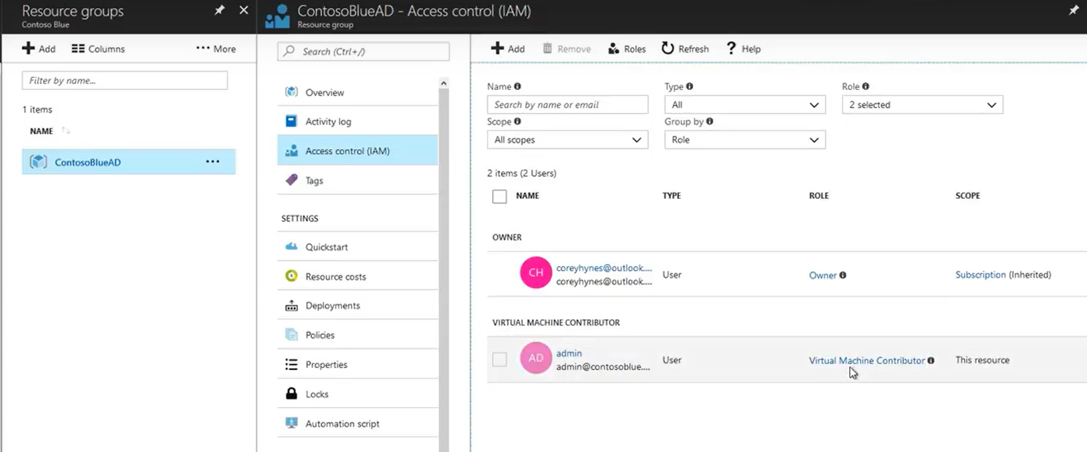
Demonstration: Role-Based Access Control

Slide 20
Additional Practice: RBAC
(Azure Portal) Grant access for a user using RBAC
Create a resource group
Assign a user to a role
Remove the role assignment
(PowerShell) Grant a user access to view resources in a subscription
Create a user
Create a resource group
List the role assignments: Get-AzureRMRoleAssignment
Remove access: Remove-AzureRmResourceGroup
Notes:
For more information, you can see:
What is role-based access control - https://docs.microsoft.com/en-us/azure/role-based-access-control/overview

Slide 21
Video: Enterprise Administrators
Enterprise Enrollment
Department A
Department B
Account A
Account B
Account C
Subscription 1
Subscription 2
Subscription 3
Subscription 4

Slide 22
Module 2: Review Questions
You are managing Azure AD for an organization and you engage a third-party consultant to assist. You need to give the consultant access to the Azure resources. What is an Azure user account? What are the three identity sources for user accounts? Which type of account would you use for the consultant?
You need to manage access permissions for an Azure tenant. What are Azure groups? What are the two basic types of groups? What are the two ways to assign members to Azure groups?
You need to define several levels of control for groups of users. The requirements for the groups are: Group1, manage everything, including access; Group 2, manage everything except access, and Group 3, view everything but do not allow changes. What is RBAC? What are the three most common roles in Azure? Which role would you use for each group? How do you view the roles in the Azure portal?
Notes:
Q1 Answer: In Azure AD, all users who need access to resources must have a user account. A user account is an Azure AD user object that has all the information that is needed to authenticate and authorize the user during the sign‑in process and build the user's access token.
Additionally, there are various sources depending on the types of identity, including:
Cloud identities (Azure Active Directory). Users that only exist in Azure AD. For example, administrator accounts or users you are managing yourself.
Directory-synchronized identities (Windows Server AD). Users brought in to Azure through a synchronization activity using Azure AD Connect. These are users that exist in Windows Server AD.
Guest users (Azure Active Directory). Users from outside Azure. For example, Google and Microsoft accounts.
Q2 Answer: A group helps organize users to make it easier to manage permissions. You can easily create and configure groups by using the Azure portal. There are two types of groups: security groups and distribution groups.
Security groups are security‑enabled and are used to assign permissions and control access to various resources.
Distribution groups are used by email applications and are not security enabled. You can easily add groups in the portal.
There are two ways to add members to Azure groups.
Directly Assigned. In this situation you create the group then you manually add individual user accounts to the group.
Dynamically Assigned. In this situation you create rules to enable attribute-based dynamic memberships for groups based on characteristics. For example, a user in the sales department is dynamically assigned to a Sales group. You can set up a rule for dynamic membership on security groups or Office 365 groups. This feature needs an Azure AD Premium P1 license.
Q3 Answer:
Managing access to resources in Azure is a critical part of an organization’s security and compliance requirements. Role-based access control (RBAC) is the capability for you to grant proper access to Azure AD users, groups, and services.
Three of the most common roles are Owner, Contributor and Reader.
Owner - Owner can manage everything, including access.
Contributor - Contributors can manage everything except access.
Reader - Readers can view everything but can't make changes.

